Slide 1



Md Abdul Malik_hm@Siramishi GPS, 01716072944

Slide 2

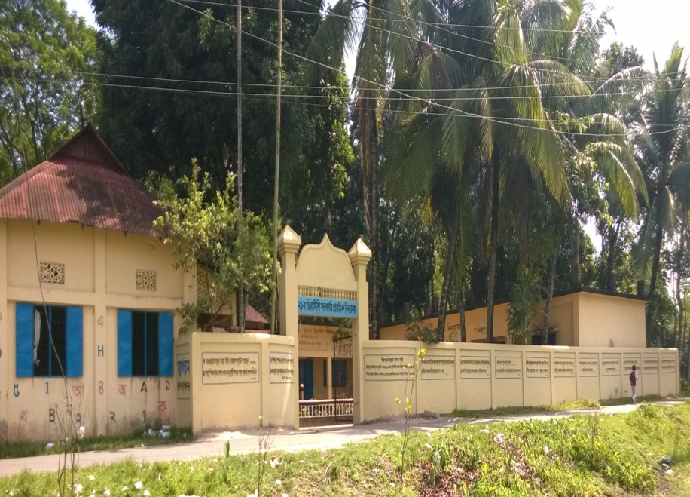
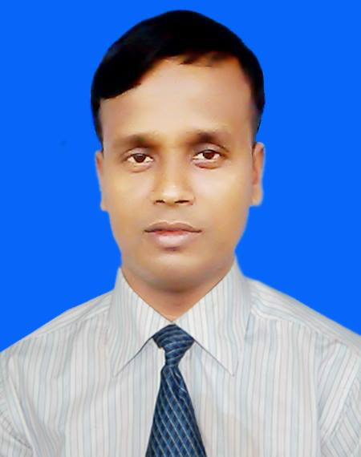
Md. Abdul Malik
Head teacher
Siramishi GPS.
Jagannathpur, Sunamgong.
Mobile: 01716-072944
E-mail:ma.malik_hm@yahoo.com
Sub: English
Class: Five
Unit: 10
Lesson : My home district
Part: A & B (Page-38)
Md Abdul Malik_hm@Siramishi GPS, 01716072944

Slide 3

Learning outcomes:
At the end of this lesson, the students will be able to…
1. Read the text correctly.
2. Ask question and answer them with the help of text information.
3. Prepare to write about their home district.
Md Abdul Malik_hm@Siramishi GPS, 01716072944

Slide 4

Where do you live?
What is the name of your village?
What is name of your district?
Today’s lesson : My home district
Md Abdul Malik_hm@Siramishi GPS, 01716072944

Slide 5

Warm up activities
Hello song
Md Abdul Malik_hm@Siramishi GPS, 01716072944

Slide 6

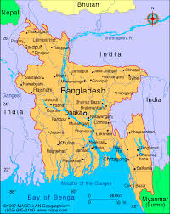
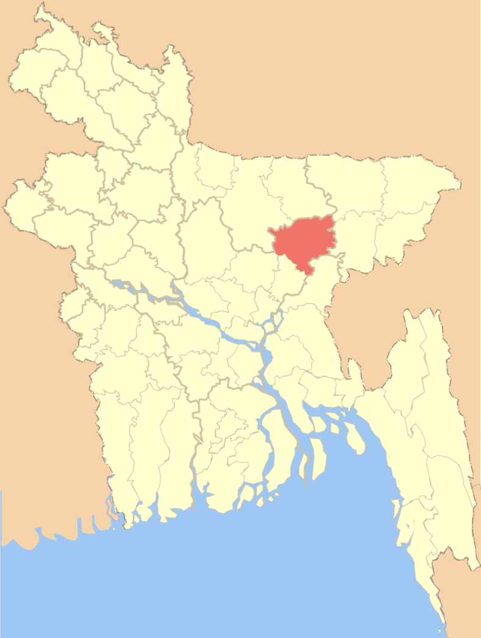
Look at the map and find out Kishoregonj.
My home district is Kishoregonj.
Md Abdul Malik_hm@Siramishi GPS, 01716072944

Slide 7

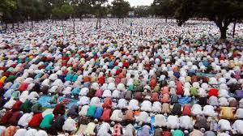
Solakia Eid Ground
Md Abdul Malik_hm@Siramishi GPS, 01716072944

Slide 8
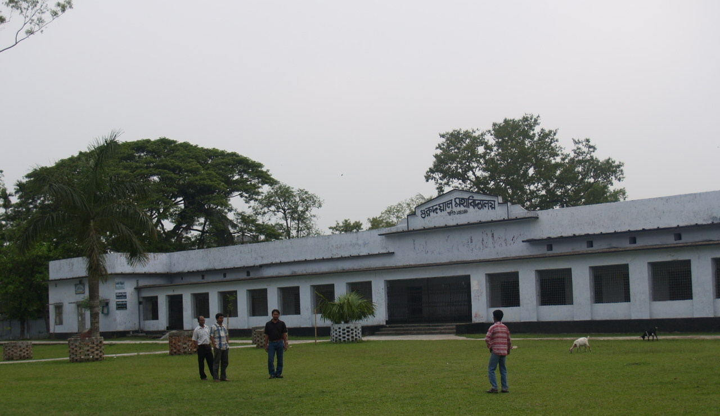
Gurudayal college
Md Abdul Malik_hm@Siramishi GPS, 01716072944

Slide 9
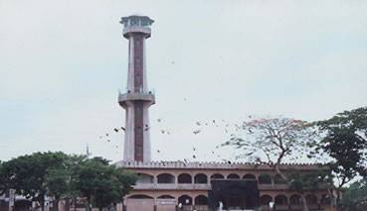
Pagla Mosque
Md Abdul Malik_hm@Siramishi GPS, 01716072944

Slide 10
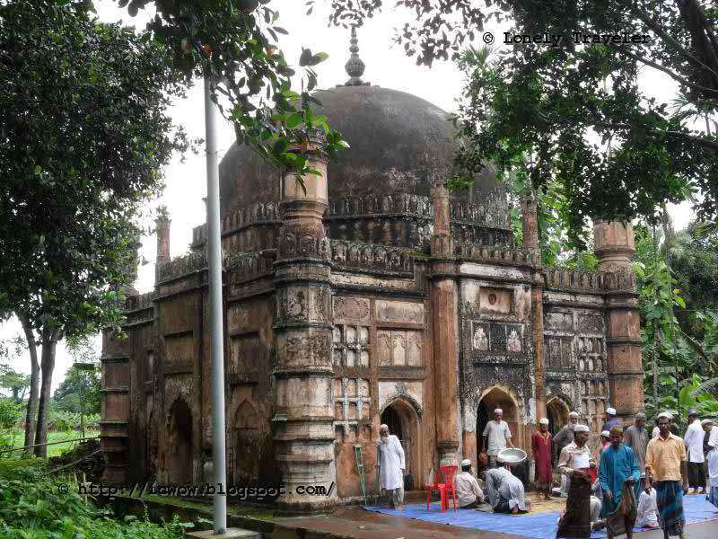
Shah Muhammad Mosque
Md Abdul Malik_hm@Siramishi GPS, 01716072944

Slide 11
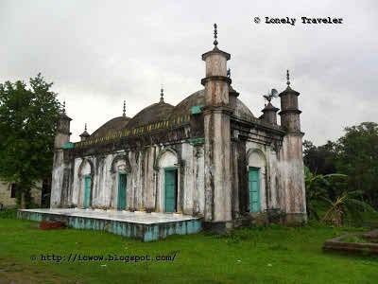
Fort of Isha khan
Md Abdul Malik_hm@Siramishi GPS, 01716072944

Slide 12

Fuleshwari river
Md Abdul Malik_hm@Siramishi GPS, 01716072944

Slide 13

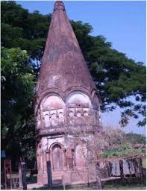
Shiva temple
Md Abdul Malik_hm@Siramishi GPS, 01716072944

Slide 14

New word
Headquarters
Landlord
Municipalities
Celebrate
Temple
Largest
?
Md Abdul Malik_hm@Siramishi GPS, 01716072944

Slide 15


Open your English book page at 38. Listen the audio very carefully and put the finger under this line.
Click here to listen the audio
Md Abdul Malik_hm@Siramishi GPS, 01716072944

Slide 16

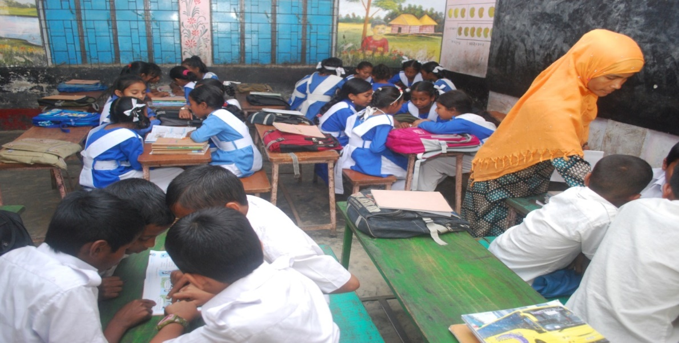
GW
Read the text in group
Md Abdul Malik_hm@Siramishi GPS, 01716072944

Slide 17
PW
Read the text in pair
Md Abdul Malik_hm@Siramishi GPS, 01716072944

Slide 18

Work in a group. Read the text again and make a list of the important places in kishoregonj.
Md Abdul Malik_hm@Siramishi GPS, 01716072944

Slide 19

Game
(Word Bingo)
Important
Landlord
Area
District
Place
Outside
Square
River
Md Abdul Malik_hm@Siramishi GPS, 01716072944

Slide 20

Evaluation
Answer the following question.
1.What’s the name of Mamun’s home district?
2. How far is it from Dhaka?
3. What is the name of the river in the town?
4. What are two things you can see in the town?
5. Who are two famous people from this town?
Md Abdul Malik_hm@Siramishi GPS, 01716072944

Slide 21

Task
Answer the following question.
1.What’s the name of your home district?
2. How far is it from Dhaka?
3. What are the interesting places in your home district?
4. What are some famous people from your home district?
5. What do you like about your home district?
Md Abdul Malik_hm@Siramishi GPS, 01716072944

Slide 22

Home Work
Write a paragraph about your home district?
Md Abdul Malik_hm@Siramishi GPS, 01716072944

Slide 23


Md Abdul Malik_hm@Siramishi GPS, 01716072944

